Slide 1
Melanoma. Classification
Using DenseNet.
Ramiz Akhtar (rsa5wj), Rayaan Faruqi (raf9dz), and Kunaal Sarnaik (kss7yy)
October 11th, 2020

Slide 2
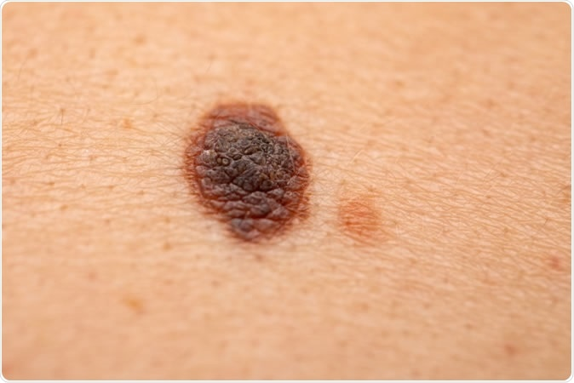
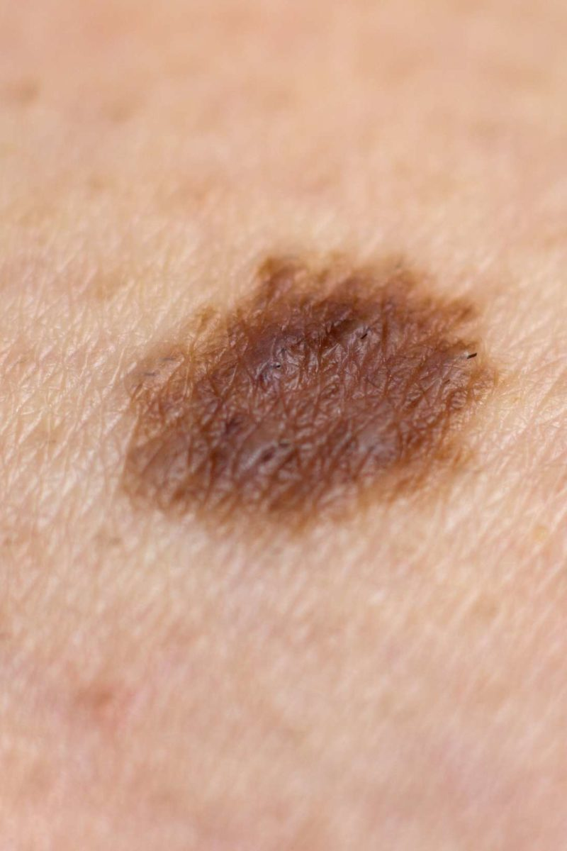
.Motivation.
What is the difference between the two images on the right?
Top - Melanoma
Bottom - Typical skin mole
Extremely difficult to differentiate which one is which
An estimated 76,380 Americans will be diagnosed with an invasive melanoma¹
While melanoma is less common than other skin cancers, it is more likely to metastasize relative to other types of skin cancers.²
What if there was a way to classify this early on?
In the safety and comfort of one’s own home (i.e., without having to obtain an expensive clinical diagnosis in person)
Providing such diagnostic information via a smartphone applications makes early detection both more feasible, accessible, and economical!
Higher likelihood of successful treatment outcome(s)
Ease of Use, Operability, and Accessibility
Raises awareness of a serious disease that affects the lives of many

Slide 3
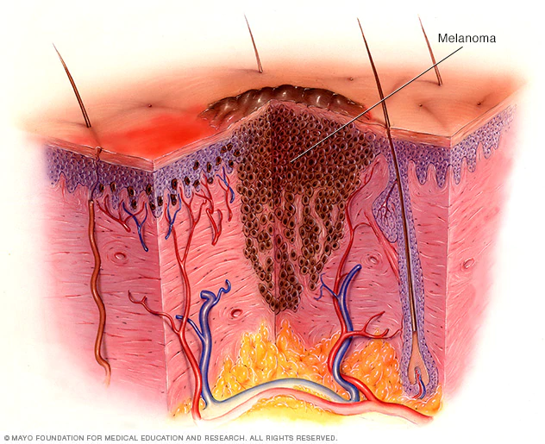
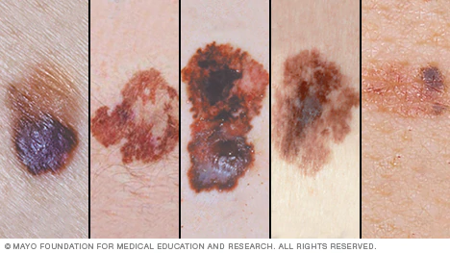
.Background.
What is Melanoma?
Per the Mayo Clinic, melanoma is the most serious type of skin cancer³
Develops in the melanocytes → The cells that gives one’s skin its pigmentation
Why is hard to diagnose?
Can develop anywhere on the body
Most melanoma cells still make melanin → usually brown or black
However, some melanomas do not make melanin → can appear pink, tan, or white
What are the clinical, financial, and psychosocial implications of a late diagnosis?
Clinical → Harder to manage melanoma progression in later stages
Financial → Higher cost of emergent operations
Psychosocial → Withdrawal from activities, avolition, and dysphoria

Slide 4
.Related Work.
Esteva et al. demonstrated dermatologist level classification of skin cancer with machine learning techniques, specifically a deep convolutional neural network (CNN)⁴
In addition to disease classification via images, as mentioned above, Chan et al. lists⁵
Disease classification using dermatopathology images
Assessment of skin disease using mobile applications and personal monitoring devices
Facilitation of larger scale dermatological and epidemiological research
Precision medicine
Substantial research has been funded to classify breast cancer tumors based on size and malignancy
Ray et. al. utilized a supervised machine learning approach to classify BC tumors based on both image and numeric datasets⁶
Dhahri et. al. optimized automated BC tumor classifiers using kNN, Random Forest, AdaBoost, etc.⁷
Relevant melanoma classification models based on numeric data and genomic data conducted
Current need: IMAGE DATA! ⁸

Slide 5
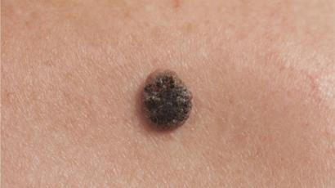
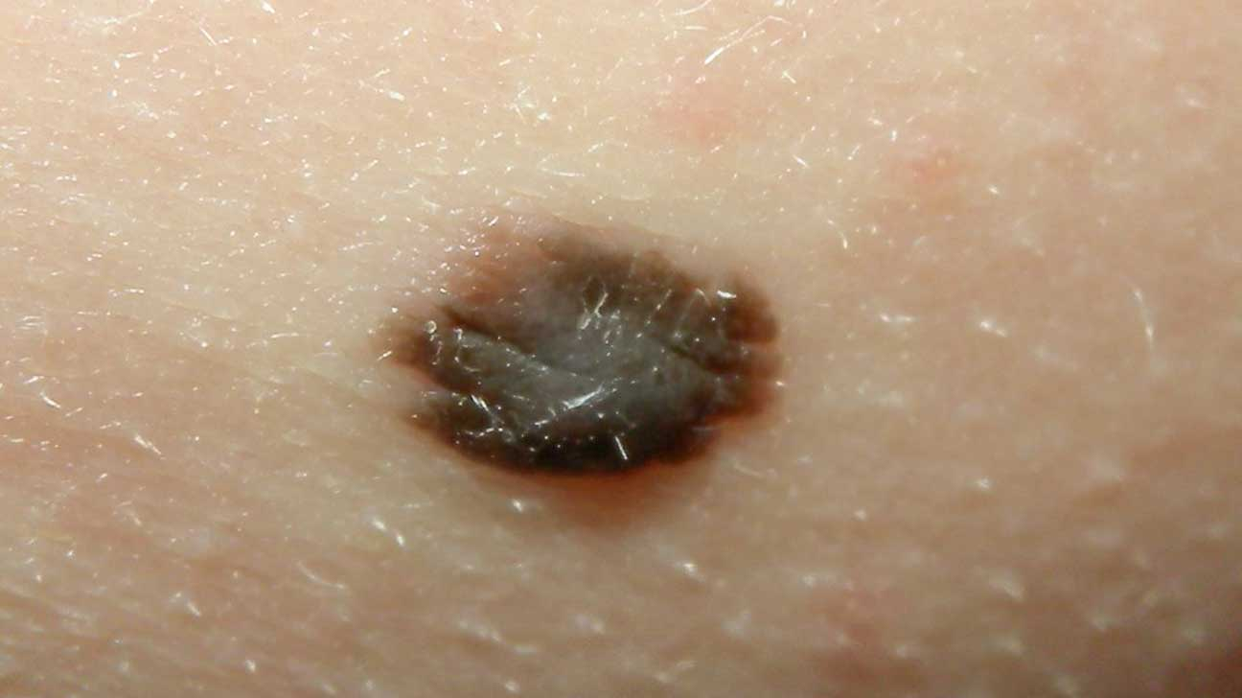
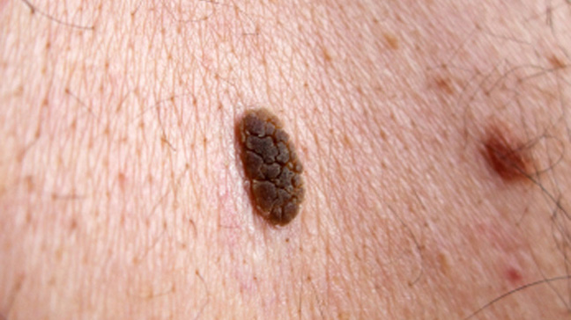
Claim/Target Task.
Using supervised multi-class classification to train and validate a model that can robustly distinguish the properties of a skin image as either:
Melanoma (top)
Non-melanoma skin (nevus) (middle)
Seborrheic Keratosis (bottom)
Dataset being utilized (2750 images of the three outcomes) : https://www.kaggle.com/wanderdust/skin-lesion-analysis-toward-melanoma-detection

Slide 6
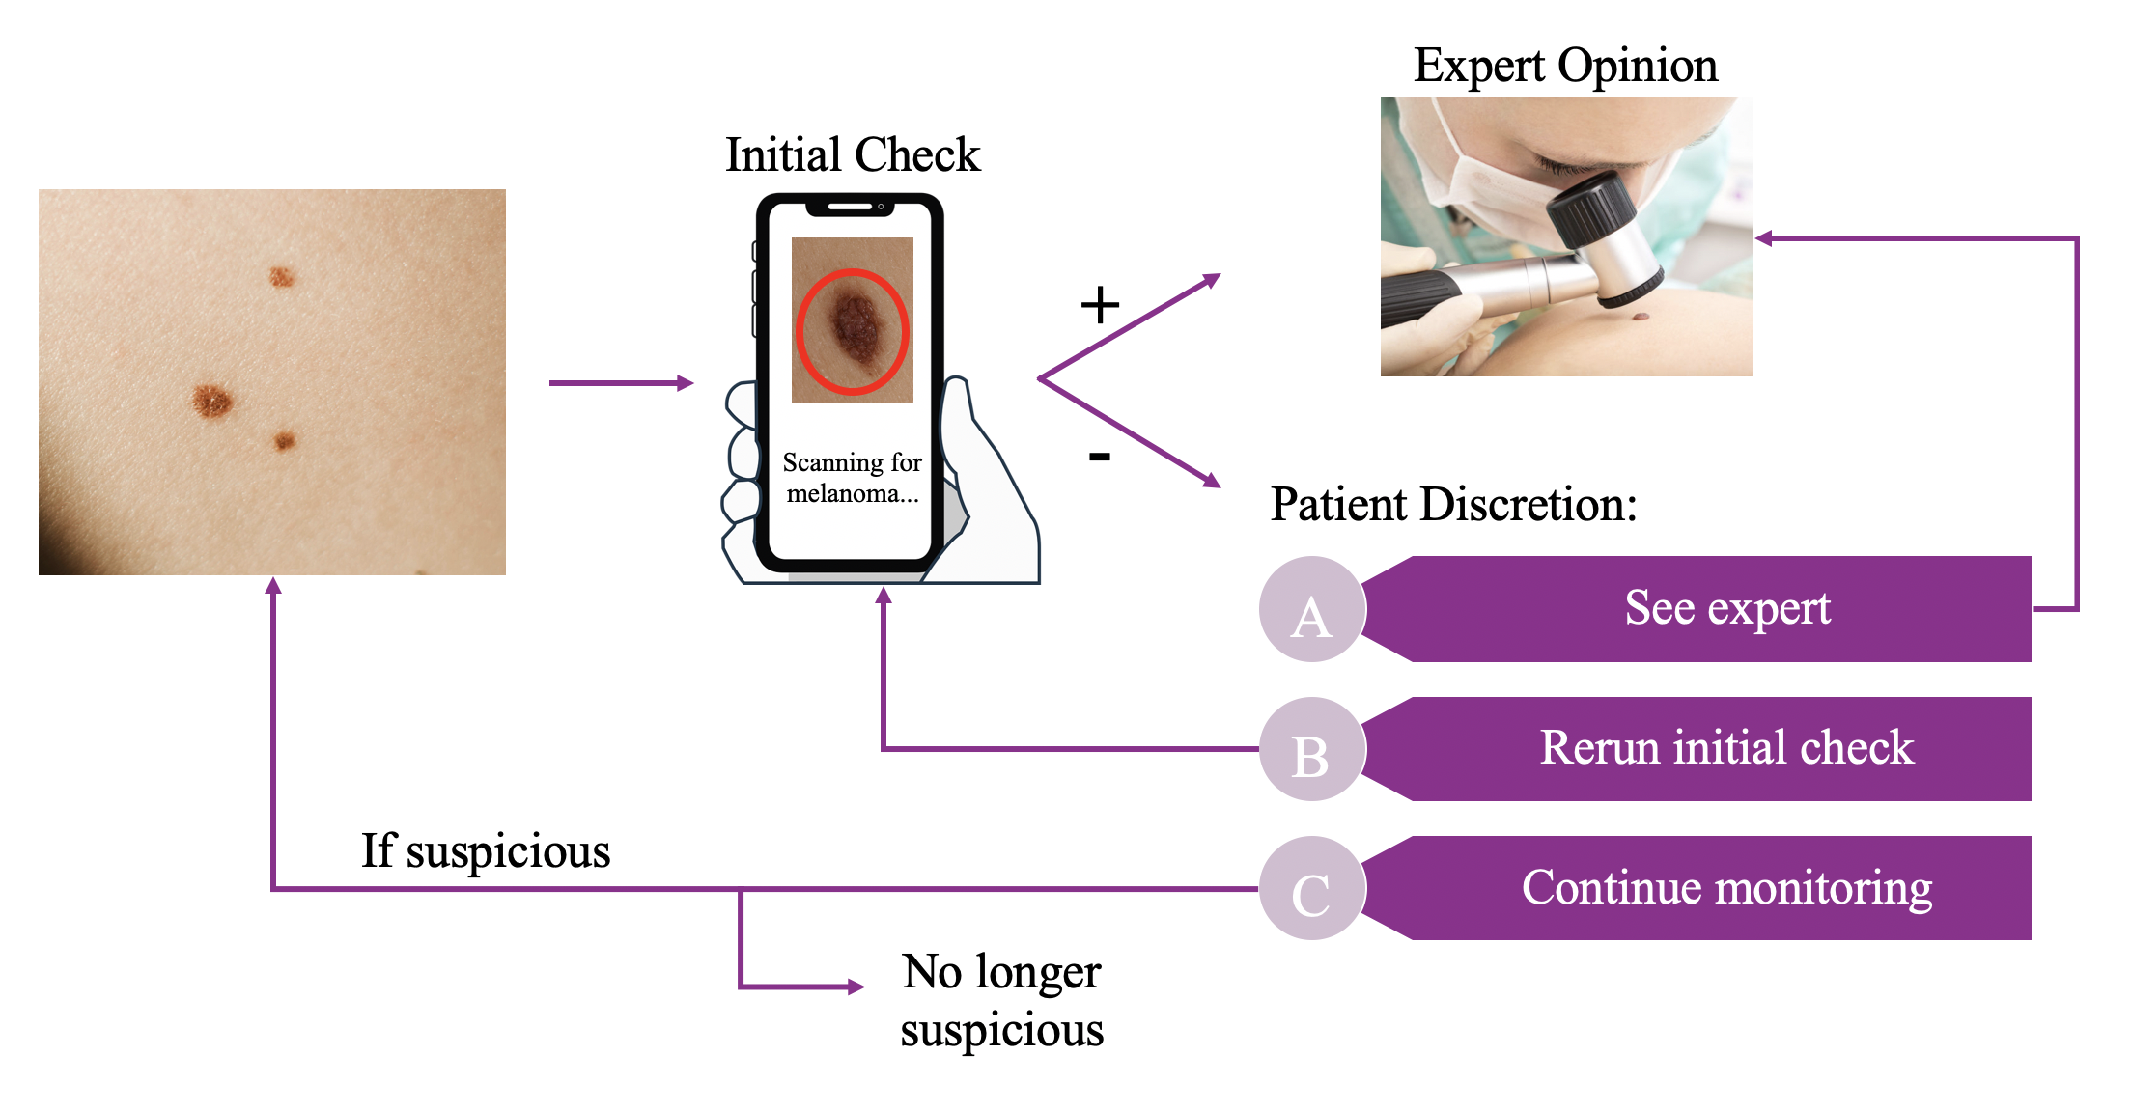
.Intuitive Figure.

Slide 7
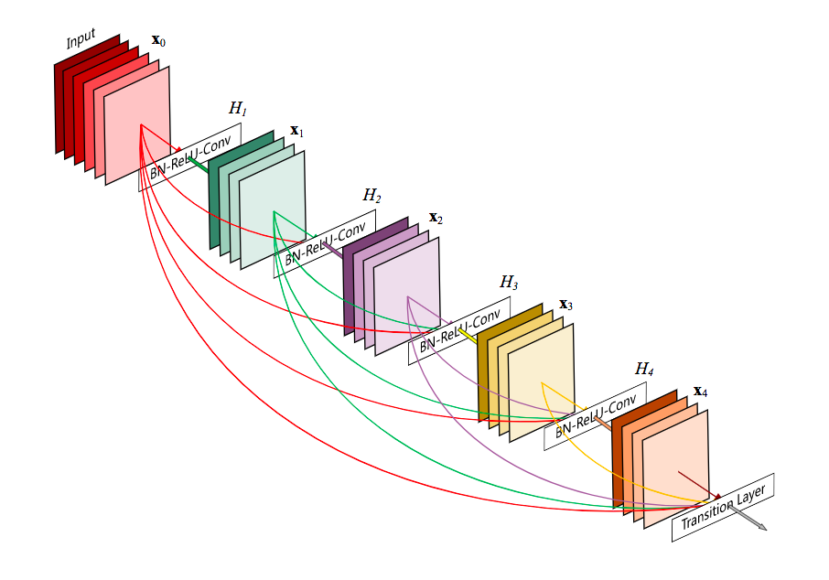
Proposed Solution.
A DenseNet implemented with Keras using a TensorFlow backend
Consists of dense blocks with internal convolutional layers, followed by a transition layer
Dense Blocks: Internal convolutional layers each consecutively connected to one another
Convolutional Layer: Batch normalization of data → ReLU activation → ending with a 3x3 convolution. Dropout of 0.2
Transition Layer: Another convolutional layer, except ending with a 1x1 convolution instead of 3x3, and ending with a max pooling layer
Example architecture visualization for a single 5-layer dense block with 4 convolutional layers, each consisting of batch normalization, ReLU activation, and 3x3 convolution. Terminates with a transition layer.

Slide 8
Implementation.
Preprocessing:
Images resized → from median size of 3008 x 2000 to 128x128
Extreme downsampling
Image pixel normalization → floating point (0, 1)
Keras ImageDataGenerator
Automatically scales, performs vertical/horizontal flipping, rotation, modifies brightness, and randomly zooms in on images within the dataset⁹
The Model:
6 dense blocks
4 convolutional layers within each dense block
A single transition layer after each dense block, including a 1x1 convolution bottleneck layer
Batch size = 12 ; Epochs = 12
Why DenseNet?
Compact internal representations that allow for reduced feature redundancy
Each layer receives all preceding layers as input → more diversified features with richer patterns
Maintains lower complexity features
Smoother decision making boundaries → performs well with insufficient training data
Notes:
https://machinelearningmastery.com/how-to-configure-image-data-augmentation-when-training-deep-learning-neural-networks/

Slide 9
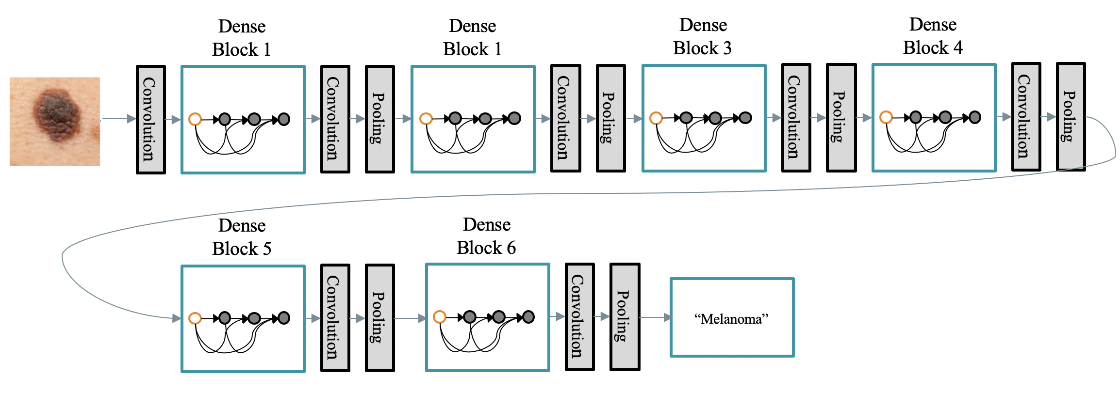
Model Architecture.

Slide 10
Contributions.
Demonstrates use of a DenseNet for melanoma classification, on a small and disproportionate data set, with highly downsampled images
Displays effectiveness of Keras automated data augmentation and DenseNet architecture in compensating for these factors
Tuned DenseNet architecture’s hyperparameters to further advance work on accurately classifying nevus skin, melanoma, and seborrheic keratosis
Advancing work on biomedical image classification
Displayed effectiveness of the cutting-edge DenseNet model versus a more traditional CNN model (see Appendix)
Notes:
Nesterov accelerated gradient (NAG) is superior to vanilla momentum → nadam

Slide 11
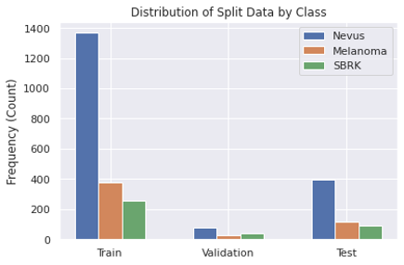
Data Summary.
Dataset → 2750 images of the three outcomes
Provided as a publicly available dermoscopy dataset by the International Skin Imaging Archive (ISIC) in 2018
Sourced from “leading clinical centers internationally from a variety of devices used at each center”
Distribution of Split Data by Class (Frequency)
 | Nevus | Melanoma | Seborrheic Keratosis (SBRK)
Training | 1372 | 374 | 254
Validation | 78 | 30 | 42
Testing | 393 | 117 | 90

Slide 12
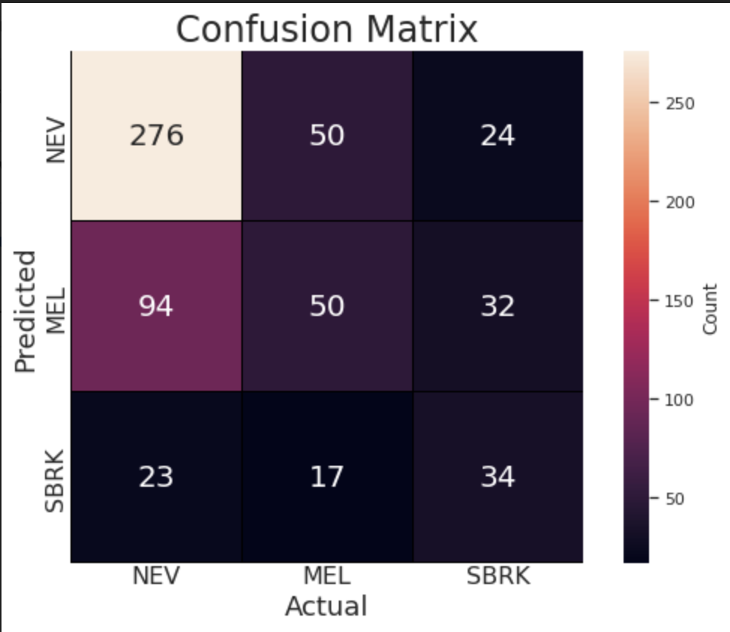
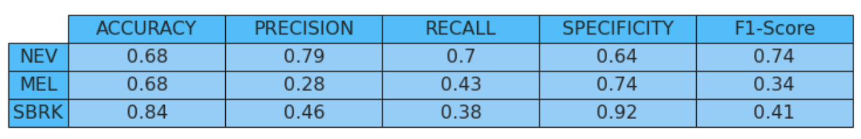
Experimental Results.
The best results were for a DenseNet architecture with a growth rate of 12, and hyperparameters as follows:
Optimizer: nadam
Learning Rate: 1e-05
Validation accuracy: 64.66%
Testing Accuracy: 60%
Other DenseNet or traditional CNN architectures were either too low in accuracy or not generalizable enough for practical use (see Appendix for results from other architectures)
Low MEL and SBRK precision and recall/sensitivity values. Moderately high specificity values for MEL and SBRK.

Slide 13
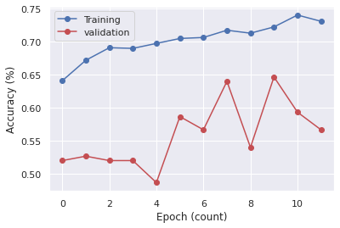
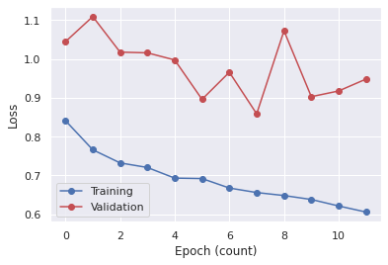
Experimental Results.

Slide 14
Experimental Analysis.
The model is not fit for practical use in melanoma classification
Model needs additional training and refinement → Low recall, precision, and insufficiently high values for specificity in MEL and SBRK
Insufficiently high specificity → model frequently misclassifies image as either MEL or SBRK
Low Recall and precision → model frequently misclassified an image (high false negative rate)
DenseNet model performed admirably given skewed, heavily downsampled dataset and computational power restrictions
Traditional CNN model heavily overfit for NEV classification due to overrepresentation of Nevus samples in the training data
DenseNet architecture was somewhat able to compensate for this imbalance in training data.

Slide 15
Conclusion & Future Work.
Conclusions:
DenseNet performed admirably despite computational and dataset limitations
Appears well suited for imbalanced data and restricted computational power
Traditional CNN severely underfit melanoma and seborrheic keratosis images (see Appendix), most likely due to disproportionate number of nevus samples
Future Work:
A UNET model architecture, assigning labels for each pixel in an image
An application of DenseNet with a larger and more balanced dataset
More computational power (i.e. more GPU power, RAM, etc.) to reduce downsampling of image data

Slide 16
References
Glazer AM, Winkelmann RR, Farberg AS, Rigel DS. Analysis of Trends in US Melanoma Incidence and Mortality. JAMA Dermatol. 2017;153(2):225. doi:10.1001/jamadermatol.2016.4512
American Cancer Society. What Is Melanoma Skin Cancer? | What Is Melanoma? Published August 14, 2019. Accessed October 11, 2020. https://www.cancer.org/cancer/melanoma-skin-cancer/about/what-is-melanoma.html
Melanoma - Symptoms and causes. Mayo Clinic. Accessed October 11, 2020. https://www.mayoclinic.org/diseases-conditions/melanoma/symptoms-causes/syc-20374884
Esteva A, Kuprel B, Novoa RA, et al. Dermatologist-level classification of skin cancer with deep neural networks. Nature. 2017;542(7639):115-118. doi:10.1038/nature21056
Chan S, Reddy V, Myers B, Thibodeaux Q, Brownstone N, Liao W. Machine Learning in Dermatology: Current Applications, Opportunities, and Limitations. Dermatol Ther. 2020;10(3):365-386. doi:10.1007/s13555-020-00372-0

Slide 17
References
Ray R, Abdullah AA, Mallick DK, Ranjan Dash S. Classification of Benign and Malignant Breast Cancer using Supervised Machine Learning Algorithms Based on Image and Numeric Datasets. J Phys Conf Ser. 2019;1372:012062. doi:10.1088/1742-6596/1372/1/012062
Dhahri H, Al Maghayreh E, Mahmood A, Elkilani W, Faisal Nagi M. Automated Breast Cancer Diagnosis Based on Machine Learning Algorithms. Journal of Healthcare Engineering. doi:https://doi.org/10.1155/2019/4253641
Genomic Classification of Cutaneous Melanoma. Cell. 2015;161(7):1681-1696. doi:10.1016/j.cell.2015.05.044
Brownlee J. How to Configure Image Data Augmentation in Keras. Machine Learning Mastery. Published April 11, 2019. Accessed December 3, 2020. https://machinelearningmastery.com/how-to-configure-image-data-augmentation-when-training-deep-learning-neural-networks/

Slide 18
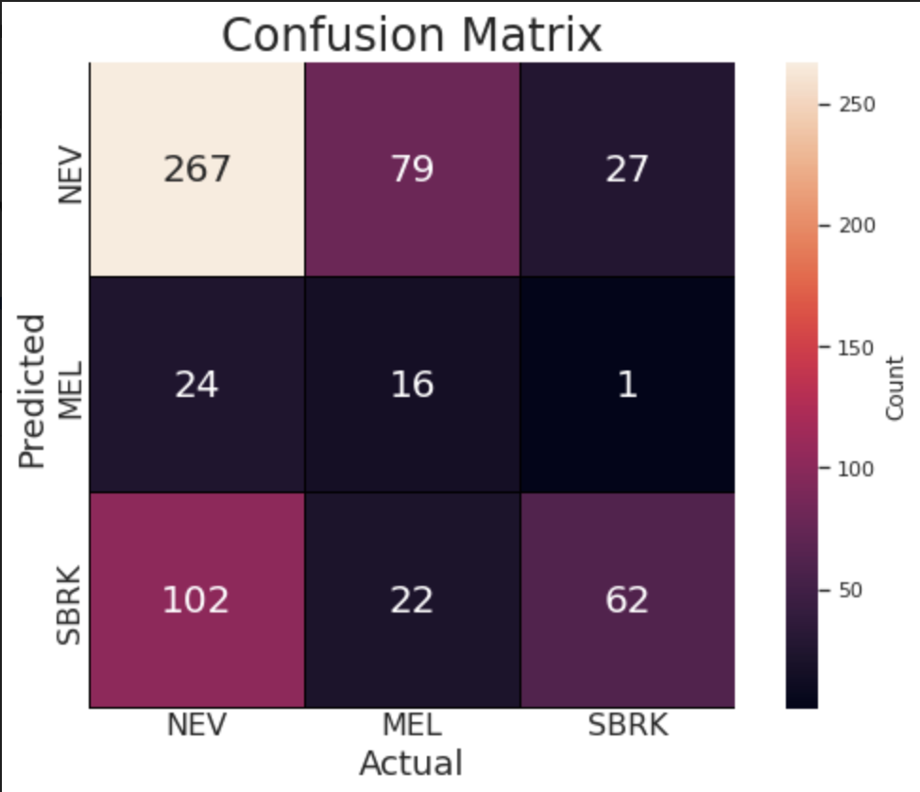
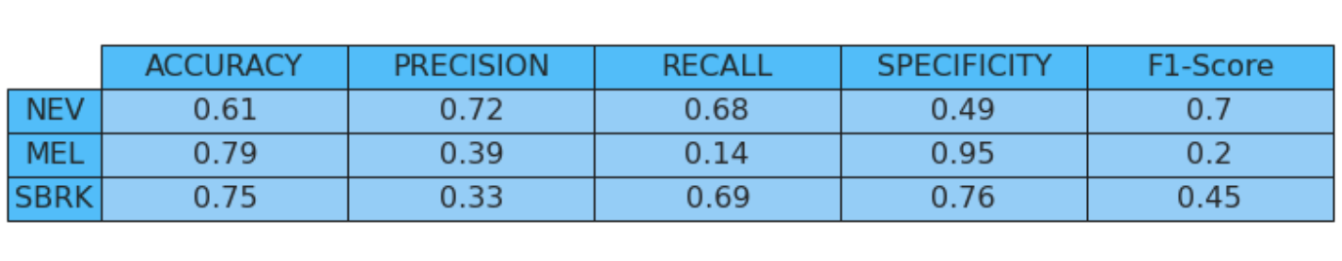
Appendix: Other Models.
These results were for a DenseNet architecture with a growth rate of 16, and hyperparameters as follows:
Optimizer: nadam
Learning Rate: 1e-05
Validation accuracy: 66.0%
Testing Accuracy: 57.5%

Slide 19
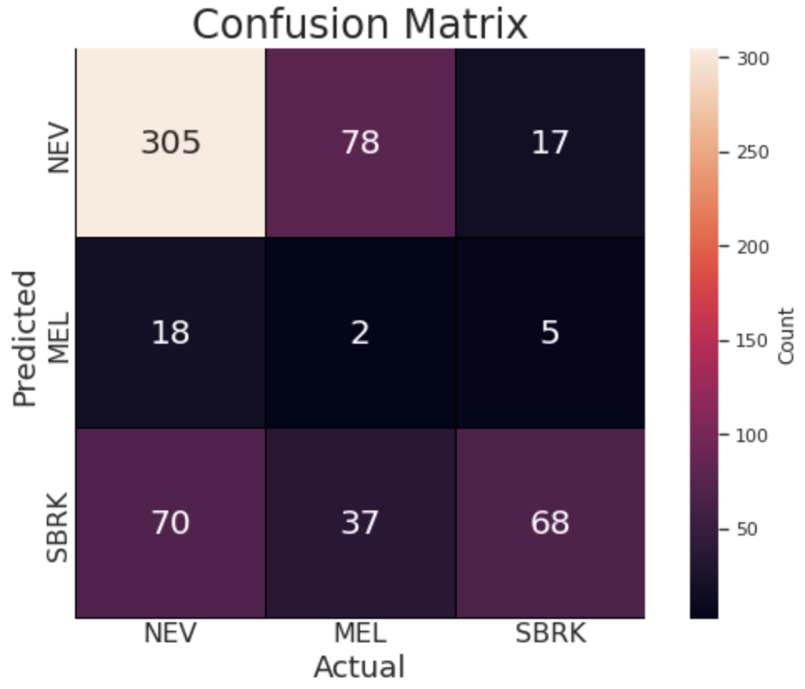
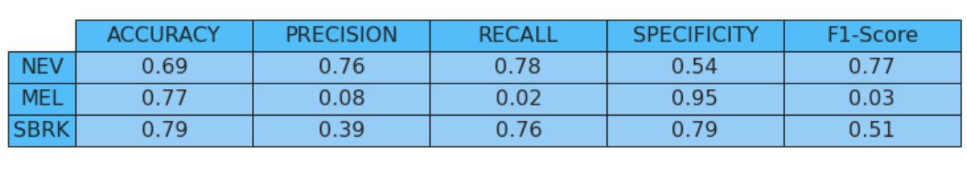
Appendix: Other Models.
These results were for a DenseNet architecture with a growth rate of 6, and hyperparameters as follows:
Optimizer: nadam
Learning Rate: 1e-04
Validation accuracy: 68.0%
Testing Accuracy: 62.5%
This model was not chosen to be the best model as it performed extremely poorly in classifying melanoma.

Slide 20
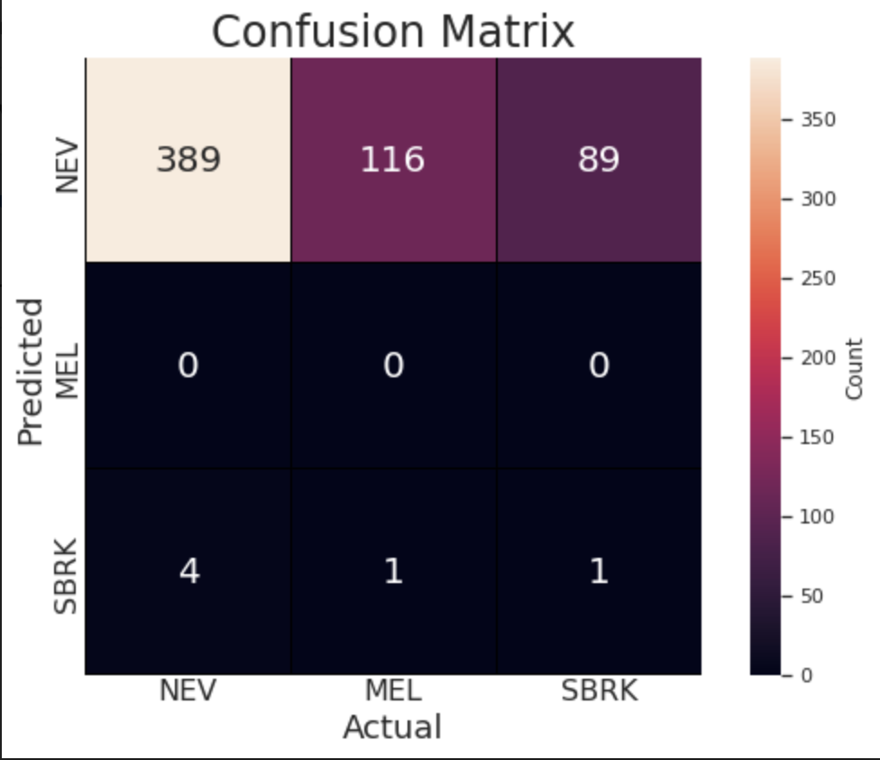
Appendix: Other Models.
These results were for a traditional CNN architecture with batch_size, epochs = 8, and hyperparameters as follows:
Optimizer: adamax
Learning Rate: 0.0001
Validation accuracy: 52.66%
Testing Accuracy: 65.0%
This model was not chosen to be the best model as it was overfit for NEV classifications .
* Statline with specificity, recall, precision, etc. not shown due to floating point division by zero error.

